Slide 1
Annual Attestation
Annual attestation is the process to ensure compliance to University’s Individual Financial Conflict of Interest Policy 1-006. This policy requires employees to file a financial disclosure to report whether they have any external financial relationships (that reasonably appear to be related to their professional responsibilities to the university), so that potential financial conflicts of interest can be properly identified.
The online disclosure form is completed in the Business Relationship Reporting System. It is due at the start of fall semester each year and should be kept up to date. See more information at https://COI.utah.edu/annual-attestation.Php.
A disclosure should be filed even if there is nothing to report. An updated disclosure is needed if you haven’t filed since July 1, 2025.

Slide 2
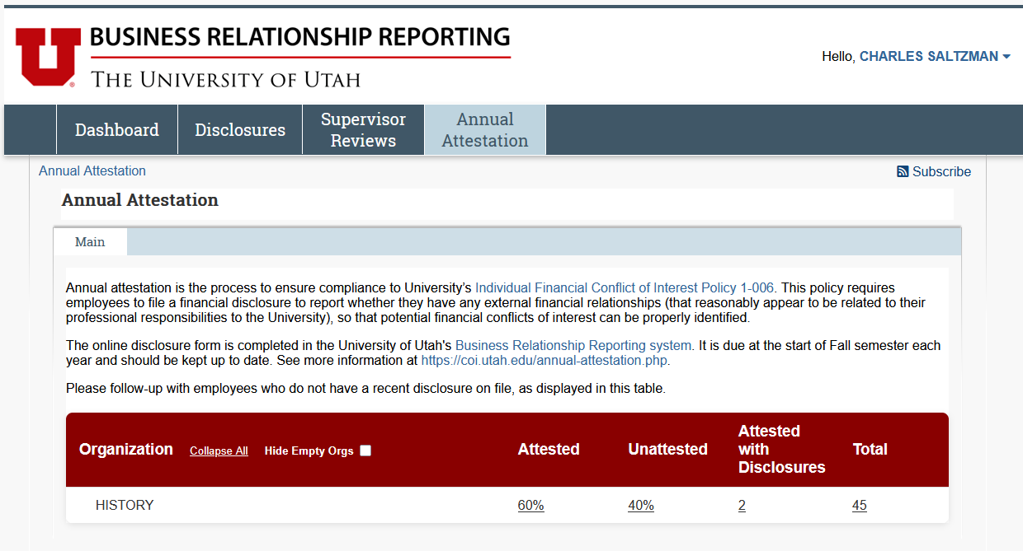
Compliance (Annual Attestation) Tab: for all leadership
Department Heads and other leadership have access to the “Compliance (Annual Attestation)” tab within the BRR site. This provides an overview of the unit’s attestation status. Your view is tailored to your role in the organization structure.
Additional personnel can be granted access to the dashboard (as determined by those Department Heads) if other support within the group is needed to assist in compliance monitoring. File an ORIS ticket or request the “Compliance Champion” role from COI@utah.edu.

Slide 3
Compliance (Annual Attestation) Tab: for all leadership
Data for primary department/appointment is managed by Human Resources (HR). Please contact your HR representative if you have questions or to request an update. Data is synced monthly, but users can still file a BRR disclosure while those updates are pending (the user should change their current supervisor on the Certification page in BRR, if supervisor name is required).
Clicking on any of the underlined numbers in the columns will bring up a view with a breakdown of the of the employees for that category.

Slide 4
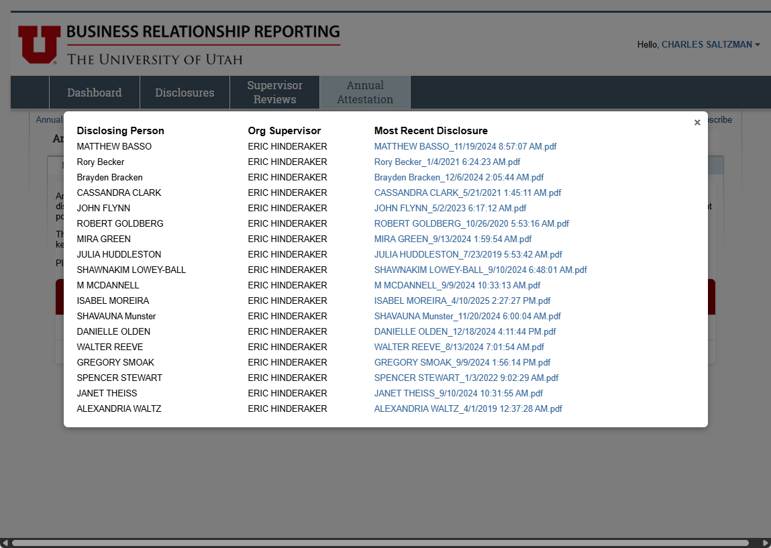
Compliance (Annual Attestation) Tab: for all leadership
Clicking on any of the underlined numbers in the columns will bring up a view with a breakdown of the of the employees for that category.
This view provides the names of the affected employees, their direct supervisor, and (if applicable) a link to a PDF of their most recent disclosure.

Slide 5
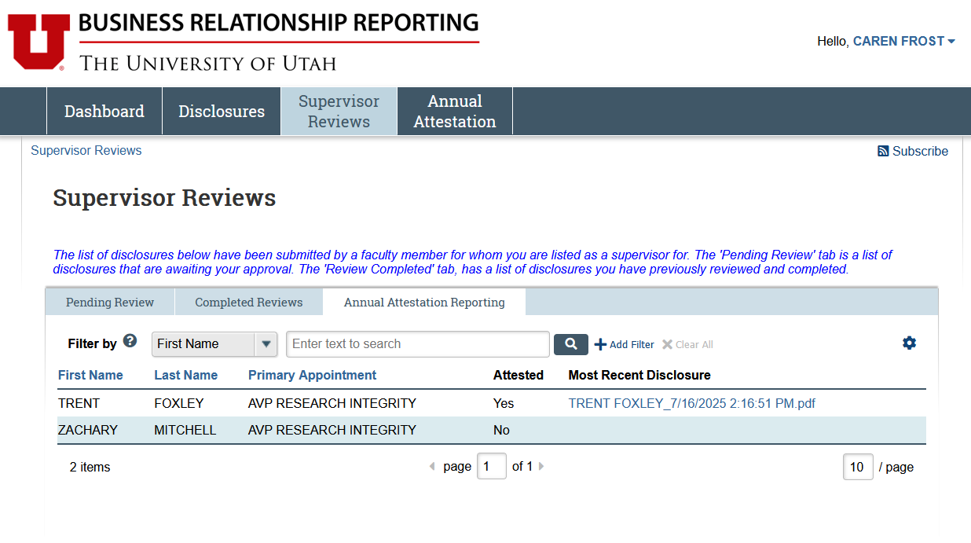
Supervisor Reviews Tab: for HS direct supervisors ONLY
Direct supervisors in Health Sciences can also track their direct reports under the Supervisor Reviews tab. This feature is not yet available for Main Campus.
A breakdown of the attestation status for your direct reports can be found under the “Annual Attestation Reporting” tab on the table within the “Supervisor Reviews” Tab on the BRR site.

Slide 6
Supervisor Reviews Tab: for HS direct supervisors ONLY
The Attestation Status for individuals can be found under the “Attested” column.

Slide 7
Supervisor Reviews Tab: for HS direct supervisors ONLY
A link to a PDF copy of the employees most recent disclosure can be found under the “Most Recent Disclosure” column.

