Slide 1
BRR Training - Staff
Site Navigation – User/Disclosure Look up

Slide 2
Site Navigation

Slide 3
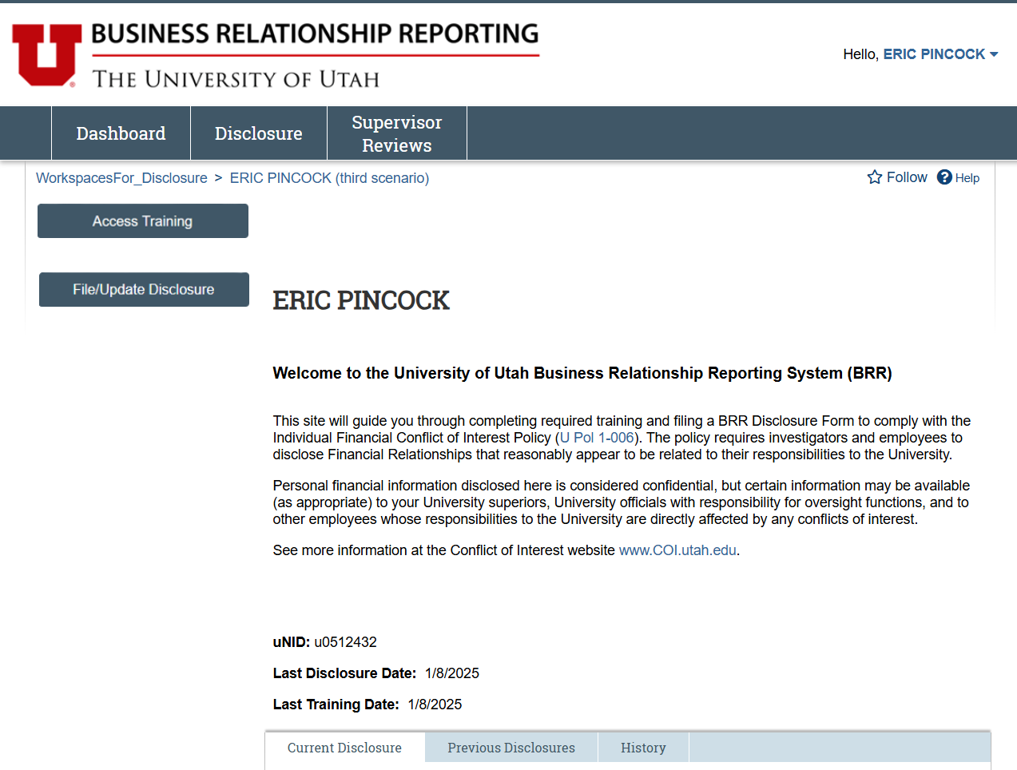
Site Navigation
When you first sign into BRR you’ll be sent to the Dashboard page, this will have information related to your own disclosures.
The buttons on the left-hand side for “File/Update Disclosure” and “Access Training” can be used to update your training status, or to create/file or update your current disclosure.
For more information on those processes, you can look over the BRR – Basics Guide.

Slide 4
Site Navigation –
Cont.
The tabs at the top of the screen will be the primary way that you navigate between the pages within BRR.
Dashboard – This is the home page where you can add trainings, update/file a disclosure, and find information related to your own disclosures.
Disclosure – This tab is used for searching for users and disclosures.
Supervisor Reviews – This tab is only used by users who have been set as a supervisor for another employee and need to perform a review of those employee’s disclosures.

Slide 5
User/Disclosure Look-up

Slide 6
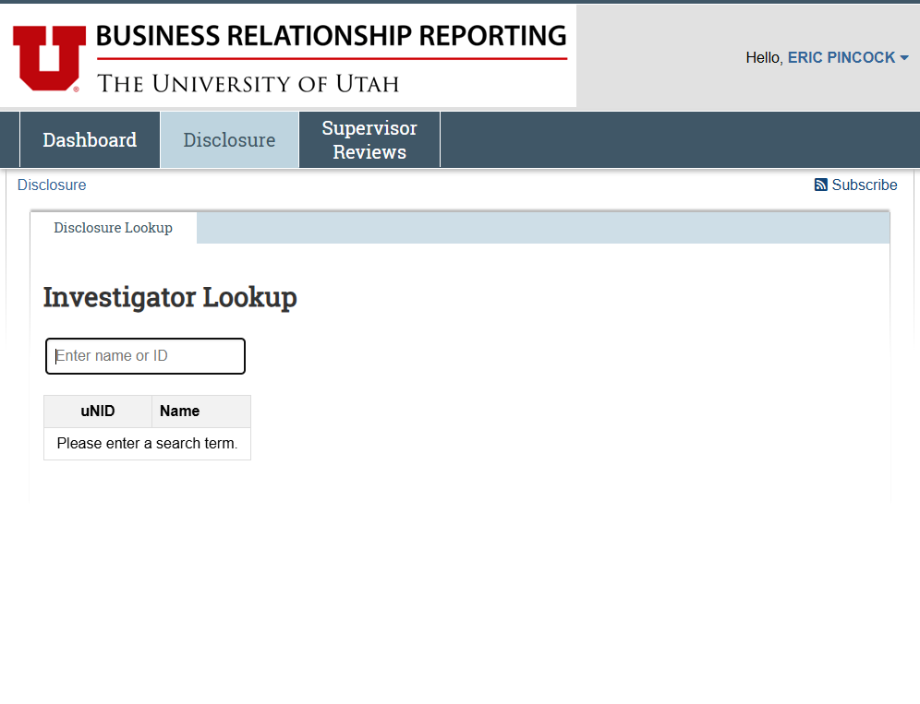
User/Disclosure
Lookup
The Disclosure tab is used to search for a user.
When searching for a user it uses the user’s name or their UNID to find them. It takes one argument, so you want to provide it with either:
User’s first name
User’s last name
User’s UNID
Adding more than this will not return any results.

Slide 7
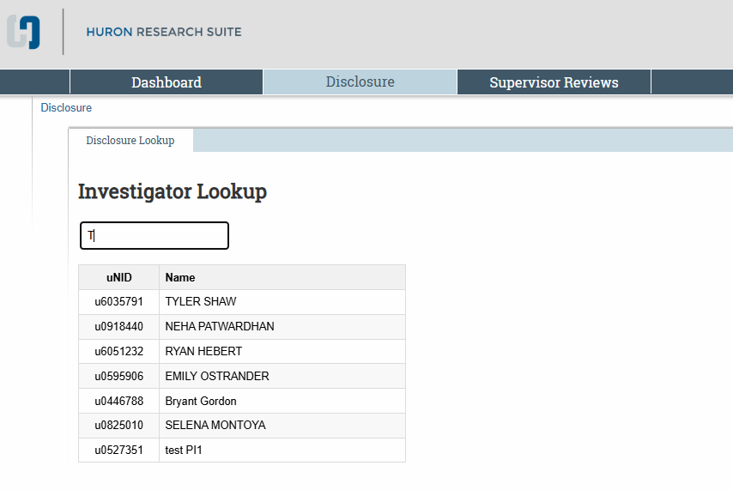

User/Disclosure
Lookup – cont.
Here’s an example of how the search results appear on the page.
To view the user’s disclosure and information you just need to click on the desired user’s name.
This will navigate you to the user’s page where you can access their disclosures.

Slide 8
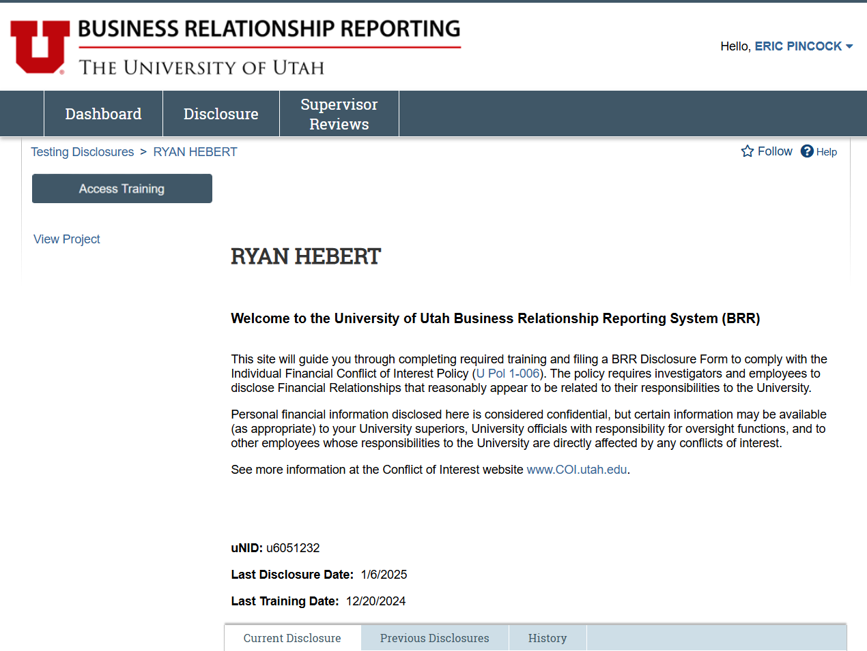
User/Disclosure
Lookup – cont.
The user’s page will look very similar to your own home page. With an overview of the information contained in their disclosure.
To access the detailed view of their submitted disclosure you will want to click on the “View Project” button on the upper left-hand portion of the page.
This will take you to an application view of the disclosure, using the same format as a submitted disclosure.

